Slide 1
The Early Cold War and Post WWII America
The Truman Doctrine, The Marshall Plan, The Berlin Airlift, and NATO

Slide 2
Overview
After WWII European nations were devastated
Left with two conflicting Ideals
Democracy (United States)
Communism (Soviet Union)
Policies like:
The Truman Doctrine
The Marshall Plan
The Berlin Airlift
the creation of NATO
Showed the US agenda of promoting Democracy post WWII

Slide 3
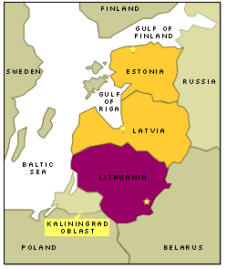
Grabbing up Territory
USSR Annexed
Baltic States (Estonia, Latvia, Lithuania)
Poland (installed a puppet gov’t)

Slide 4
United Nations Formed
The UN was formed in 1945 to address world peace.
51 original members. 60 by 1950.
Charter says the UN will mediate disputes to prevent wars.

Slide 5
Crisis in Iran
First crisis btw U.S. & USSR
Iran occupied during WWII
Allies agreed to leave after war
USSR did not leave (wanted oil revenue)

Slide 6
Crisis in Iran
Iran complained to UN
USSR finally agreed to leave but wanted the right to drill for oil
Iran agreed and then reneged a year later
Suspicion grew btw USSR & US

Slide 7
The Truman Doctrine (1947)
Provided aid to Greece and Turkey
Why?
Greece in civil war
Soviets backing communist Greeks
Thought the victory of Grecian communists would threaten Turkey
Location of Greece and Turkey

Slide 8
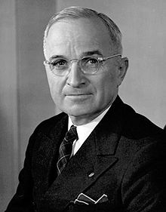
Truman said…
…that the United States was compelled to assist "free peoples" in their struggles against "totalitarian regimes," because the spread of authoritarianism would "undermine the foundations of international peace and hence the security of the United States."

Slide 9
U.S. Overall Policy of Containment
Containment: United States policy using a number of strategies to prevent the spread of communism abroad
Examples of policies
Truman Doctrine
NATO- mutual defense pact
The policy of containment is most strongly associated with Harry Truman’s presidency, but other Presidents will use it as well.

Slide 10
Containment Tested
Containment tested in Greece
Communist revolution vs monarchists
U.S. aided monarchists (400 M to Greece and Turkey)
Truman said if Communism was allowed in Greece, it would spread elsewhere.

Slide 11
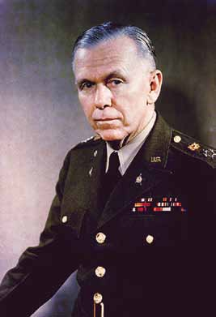
The Marshall Plan
Who is George Marshall?
Chief of staff during WWII
Diplomat after WWII
Became Secretary of the State in 1947
Eventually won Nobel Peace Prize

Slide 12
The Marshall Plan (1948)
AKA: European Recovery Plan (ERP)
American money to recovery of Western Europe
Did NOT include Eastern Europe or Soviet Bloc
Effects/Results
Western European nations can rebuild
Industrialization flourishes
Stimulated US economy

Slide 13
Similarities and differences between Marshall Plan and Truman Doctrine?

Slide 14
Berlin Airlift
After WWII, Berlin was split
West Berlin: Democratic-US, Britain, France
East Berlin: Communist-Soviet Union
Soviets wanted control of all of Berlin, closed down all railroads, highways, and canals into the city
Thought it would force the US, British, and French out
Instead of retreating, they supplied Western Berlin with supplies by air

Slide 15
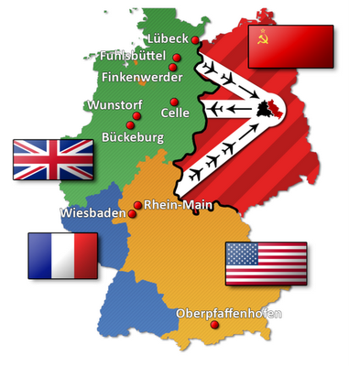

Slide 16
NATO
United States
United Kingdom
Belgium
Canada
Denmark
France
Norway
Netherlands
Iceland
Italy
Portugal
Luxembourg
Created 1949
North Atlantic Treaty Organization
12 original members came together to provide security against the Soviet Union, including…

Slide 17
Warsaw Pact
The Soviets reacted to the establishment of NATO by creating the Warsaw Pact in 1955
Made up of Central and Eastern European countries:
Soviet Union
Albania
Bulgaria
Czechoslovakia
East Germany
Hungary
Poland
Romania

Slide 18
U.S.S.R. Controls Post War Eastern Europe
Satellite State: Political term for a country that is technically independent, but is under strong political and economic control of another country.
After WWII: most eastern and central European countries were occupied by the Soviet Union
The Warsaw Pact nations were considered satellite states
Many remained under Soviet control throughout the cold war

