Slide 1
Early Cold War Conflicts: Democracy vs. Communism in Asia
Japan, Korea and China

Slide 2
Building a New Japan
What to do with Japan?
Japan lost its Empire following WWII
Question: who would govern them?
MacArthur and the Constitution
MacArthur occupies Japan for 7 years
Abolishes the Japanese military
Starts new government with a new constitution
The new constitution is based on a Representative democracy
Japan and the US form an alliance

Slide 3
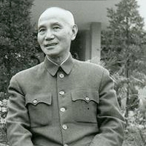
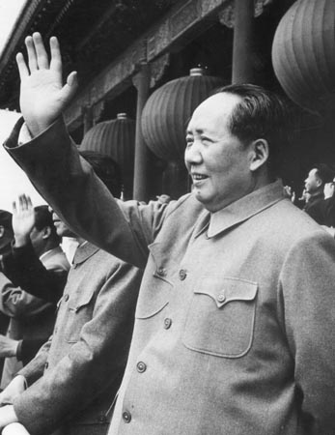
China
Nationalist
Communists
Leader: Chiang Kai-shek
US backed and supported
Mao Zedong
Soviet backed and supported

Slide 4
China
Nationalist
Communists
Corrupt government practices
Lost popular support of Chinese peasants
Gained strength
Encouraged literacy and improved food production
Civil War between two groups
US sent aid to Nationalists, but still tried to make peace
Weak leadership and corruption lead to further loss of support
China becomes People’s Republic of China (PRC) under communist rule

Slide 5
Nationalists flee to Taiwan
The UN recognizes Taiwan and
not the communist PRC in its council
Where is Taiwan?

Slide 6
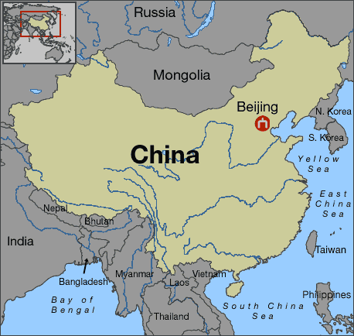
←

Slide 7
China becomes communist
Americans stunned
Why? Failure of containment policy. Communism takes hold in China.
Fear of communism in the United States grows

Slide 8
The Korean War
Truman is Commander in Chief at beginning of the conflict
Eisenhower is Commander in Chief when the conflict ends

Slide 9
Korea Divided
US and USSR occupy Korea
UN establishes 38th parallel because US and USSR refuse to leave Korea
Divided at the 38th Parallel
Split North and South
N= communist and Soviet Satellite
S= dictatorship and American controlled
North v. South: Korea begins a CIVIL WAR
N= Kim Il-sung
S= Syngman Rhee

Slide 10
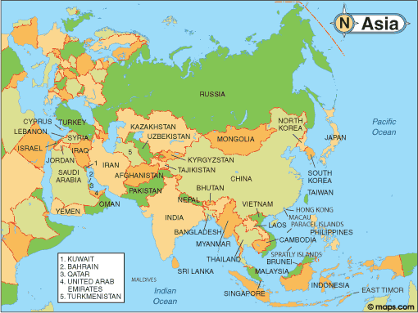
Map of Asia

Slide 11
Korean Map

Slide 12
The North attacks the South
June 1950: N. Korean troops cross 38th parallel WHY?
Surprise attack on South Korea
This began the Korean War
N. Korean troops moved deep into S. Korea

Slide 13
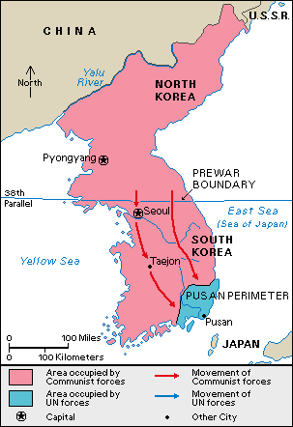

Slide 14
No official war was declared!
What is referred to as the “Korean War” is not technically a war.
The North pushing into the South is what started the Korean conflict

Slide 15
UN vote
S. Korea goes to the UN to ask for help in stopping the N. Korean invasion
UN vote → Soviets not there
The Soviets were boycotting the UN because of Nationalist China (Taiwan)
Soviets not able to veto
Vote passed

Slide 16
Truman orders troops stationed in Japan to go support S. Koreans
Forces put under General Douglas MacArthur’s command
Remember him?

Slide 17
Truman’s War
Push N. Korea back over the 38th Parallel
Containing communism
MacArthur is leader of UN troops
90% are US forced
What does this say about the state of our European allies?
Truman changes philosophy and decides to liberate N. Korea
He invades

Slide 18
MacArthur’s Downfall
Yalu River Incident
UN troops come to Yalu River border
Yalu River = border between China and N. Korea
China uses force against Americans
MacArthur wants to invade China
BAD IDEA
Truman against it
Truman FIRES MacArthur after he publically bashes the President (his boss)
Public not happy about MacArthur being fired; Truman’s popularity goes down

Slide 19
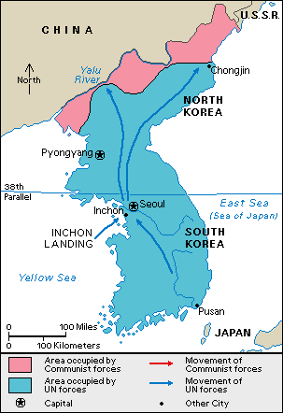

Slide 20
Ike’s Korea
1952 election
Controversy with Truman/MacArthur and cost of another military conflict cost Truman re-election
Truman LOSES re-election to Republican candidate Dwight D. Eisenhower
Peace talks began in 1951
Disagreements emerged over borders and POWs
Bomb N. Korea into submission
Secretly tell China that they will use nuclear bombs if needed

Slide 21
Stalemate
July 27th, 1953
Armistice: an agreement made by opposing sides in a war to stop fighting; a truce
Armistice signed in village of Panmunjon
New line above the 38th parallel
Prisoner exchange program

