Slide 1
Two Nations on the Edge
Eisenhower and Brinkmanship

Slide 2
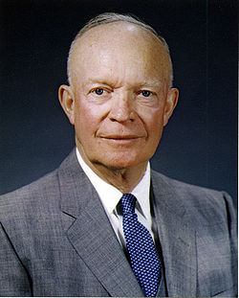
Dwight D. Eisenhower
34th President (1953-1961)
Ike
US Military Academy, West Point (1915)
General in U.S. Army in WWII
Chief of staff in Truman’s cabinet

Slide 3
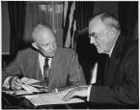
Brinkmanship
The policy was created by Eisenhower’s Secretary of State, John Foster Dulles
Dulles was very anti-Communist
Believed any compromise on the matter was immoral.

Slide 4
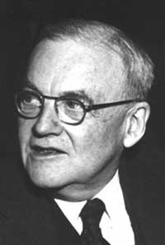
John Foster Dulles
U.S. secretary of State under Eisenhower, 1953-1959
Aggressive position against
communism throughout
the world

Slide 5
Brinkmanship: What is it?
The practice of pushing a dangerous situation to the limit of safety before stopping
The US will take every crisis to the edge (brink) of nuclear war to fight for our beliefs.
The willingness of the Eisenhower administration to go to war
Expanded the Air Force and nuclear weapons programs

Slide 6
New Weapons
H-Bomb = Hydrogen Bomb
67 times more powerful than the “Little Boy” bomb dropped on Hiroshima
US and USSR raced to see which country would be the first to make it
November, 1952 US produces H-Bomb
August, 1953 USSR produces H-Bomb

Slide 7
New Weapons
Central Intelligence Agency
CIA
Used spies to gather info abroad
Covert secret missions/operations to overthrow governments that looked unfriendly to the US
Iran
Guatemala

Slide 8
America, Iran and Operation Ajax
Post WWII, British Company AIOC controlled Iran’s oil fields.
Iranian people believed that the company was benefitting and the Iranian people were not.
The Shah (Iran’s authoritarian monarch) lost power to democratically elected Muhammad Mossadeq, who wanted to renegotiate the agreement. When the Iranian people supported Mossadeq, the Shah became powerless.
Countries in response boycotted Iranian oil.
By 1953, Mossadeq wanted to “nationalize” Britain’s AIOC and refused to work with the United States.
U.S. feared he was going to join forces with the Soviet Union.
U.S. (CIA) and British (M16) helped overthrow Massadeq and put the Shah back in total power. (Operation AJAX)
Shah establishes a 25 year dictatorship that is supported by the United States.
Iranians hated the Shah, and resented the United States.

Slide 9
America and Guatemala
U.S. businesses (United Fruit Company) were well established in Guatemala
Elected Guatemalan president, Arbenz, oppressed his opponents once he was elected and also began receiving arms from the Soviet Union.
U.S. feared that the Soviets would establish influence and a “base of operations” in Latin America (OUR HEMISPHERE) and also it threatened U.S. businesses when he wanted land reform.
U.S. supported efforts by Colonel Armas (through CIA assistance in recruiting military supporters and supplies. Armas assumes power after the collapse of the Arbenz government when the Guatemalan military turned against him.
This government was more “agreeable” to U.S. policies and goals.
Guatemala was still unstable, and Civil War erupted 6 years later.

Slide 10
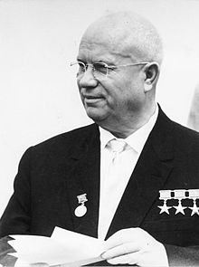
Nikita Khrushchev
Soviet Prime minister 1957-1964
Believed communism would take over the world
Peaceful competition between communism and capitalism
Scientifically and economically

Slide 11
Space Race
October 1957: Soviets launched Sputnik satellite
World’s first artificial satellite
American’s shocked, pours money into science programs. (October Sky)
January 1958: US launches first satellite

Slide 12
U-2 Incident
1955 Geneva Summit conference
Eisenhower proposes “open skies” to Khrushchev
US and USSR would allow flights over each other
Tog gaurd against nuclear attacks
Soviets reject “open skies”

Slide 13
U-2 Incident Cont.
CIA starts making secret flights over Soviets
Plane used called U-2
Flew at high alt without being detected
Used to take pictures of troop movement and missile sites
US officials uncomfortable about U-2 missions
Dulles gets Eisenhower to agree to “one last flight”

Slide 14
U-2 Incident con’t
Francis Gary Powers: pilot on last U-2 mission
Shot down over Soviet territory
Parachutes to safety
Spent 10 years in Soviet prison
Eisenhower denied the U-2 had been spying
Soviets had evidence
Eisenhower comes clean; would not apologize
Khrushchev angry
Tension grows moving into 1960s

Slide 15
Eisenhower Doctrine
“A special message to congress on situation in the Middle East”
Pledge to support any Middle Eastern nation against a communist attack

Slide 16
January 1957 speech to Congress
American forces to protect Middle East against overt aggression from nations "controlled by international communism”
Also urged the providing economic aid to those countries with anti-communist governments.
This new foreign policy became known as the Eisenhower Doctrine.

