Slide 1
Social Psychology: Major Concepts and Examples
AP Psychology

Slide 2
Appeal: Emotional, Cognitive, or Behavioral?
Emotional Appeal: Feelings and emotions about the object of an attitude. Ad appeals primarily to your emotions…”pulls on the heartstrings”.
Cognitive Appeal: Your beliefs, thoughts, or ideas about the object of an attitude. Ad appeals through the use of “facts”, “evidence” or “statistics”.
Behavioral Appeal: A predisposition to act in a particular way. Ad Appeals to what we believe to be socially acceptable or unacceptable behavior.

Slide 3
You have an “attitude” about many issues…for example: Exercise
Cognitive Component: “Exercise is good for your health.” ,“Exercise is a good stress reliever.” ,“Exercise improves my appearance.”
Emotional Component: “Exercise makes me feel great.”, “Exercise is fun.”
Behavioral Component: “I exercise every day.”, “I read articles about exercise.”, “I buy exercise equipment.”

Slide 4
Attitude Changes and Advertisements: Appeals to Emotional, Cognitive, or Behavioral?
Crest #1
Crest #3
Volvo
GE Rebate
Nick and Norm
Crazy Eddie
Target Black Friday
Willie Horton
Marlboro Man
Puppies
Cola
Santa
Chest Pain

Slide 5
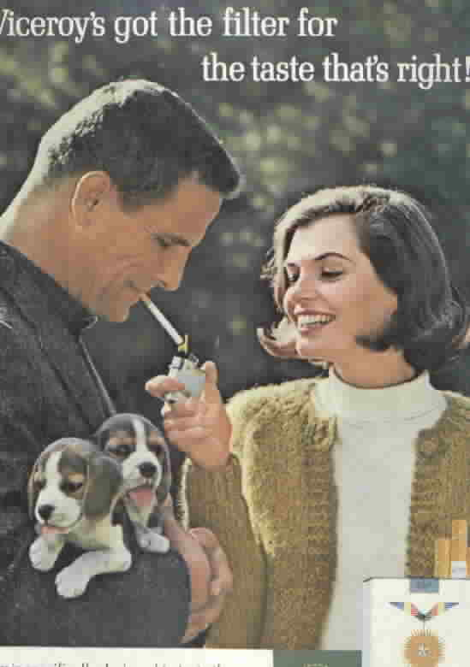

Slide 6
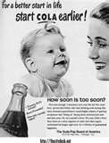

Slide 8
Attribution Theory
How do we attribute peoples behavior?
Disposition vs. Situation
Is it due to Nature (Disposition) or Nurture (Situational)
Just World Hypothesis
Tendency for people to believe the world is just and that people therefore get what they deserve and deserve what they get.
Self-Serving Bias
Tendency to perceive oneself favorably

Slide 9
Fundamental attribution error
Tendency to overestimate the influence of personality and underestimating the influence of the situations?
9/11 Terrorists…Were they obviously crazy?
Stanford Prison Experiment…Were they bad people? Can playing a “role” become “normal”? (Power of the situation)
Stanford Prison and Abu Gharib
Self-defense or Malicious intent? (Jury?)
Poverty, Social problems…(Attributed to the poor themselves, or the situation?)

Slide 10
Types of Social Influence…#1Changing those attitudes…Persuasion
Central route to Persuasion: Occurs when interested people focus on the arguments and respond with favorable thoughts.
Peripheral route to Persuasion: Occurs when people are influenced by incidental cues, such as a speaker’s attractiveness.

Slide 11
How do Attitudes Change?
Persuasion
Central or Peripheral
Central or Peripheral
Central or Peripheral
Central or Peripheral
Central or Peripheral

Slide 12
Foot-in-Door Phenomenon/Cognitive Dissonance
The tendency for people who have first agreed to a small request to comply later with a larger request.
Evidence that attitudes can follow behavior.
Cognitive Dissonance: The theory that we act to reduce the discomfort (dissonance) we feel when two of our thoughts are inconsistent. (Aligning our attitudes with our actions) This can include harmful behaviors, voting behaviors, etc.
Heaven’s Gate and Jonestown

Slide 13
2 more types of Social Influence
Obedience to Authority: Milgram, Asch
Normative Social Influence: results from a person’s desire to gain approval or avoid disapproval.
Informational Social Influence: results from one’s willingness to accept other’s opinions about reality.
Burn the church
Karate Kid

Slide 14
And…Conformity
Conformity
Adjusting our behavior or thinking toward some group standard.
Sensitive to social norms (normative influence)
Accepting opinions about reality (informational social influence)
Sesame Street
Elevator
Solomon Asch

Slide 15
Group Influence
Social Loafing: Tendency for people in a group to exert less effort when pooling their efforts towards attaining an common goal than when individually accountable.
Group Polarization: The enhancement of a group’s prevailing inclinations through discussions within the group.

Slide 16
Deindividuation: Loss of Self
The loss of self-awareness and self-restraint occurring in group situations that foster arousal and anonymity.
Looting and Rioting
Katrina
Vancouver
Lord of the Flies

Slide 17
The Bystander Effect: Any particular Bystander is less likely to give aid with other bystanders present.
Darley and Latante
What would you do?
Boondock Saints
Seinfeld and the Good Samaritan Law
Why do we fail to act?
Diffusion of Responsibility?
When Will we act?
We know the victim
Flying solo

Slide 18
Aggression in Television
Identifying Aggressive Behaviors
Assessing Violence in Children’s Cartoons
Tom and Jerry
Wile E. Coyote
Bugs Bunny
Stereotyping and Sitcoms
Assessing Pro-Social Behaviors in Children’s Cartoons

Slide 19
Hodgepodge…To name a few more…
Illusory Superiority: The tendency to overestimate your positive abilities and underestimate your negative ones.
Dunning-Kruger Effect: Bias in which an unskilled individual makes erroneous conclusions, and doesn’t recognize their mistakes.
Altruism: The unselfish regard for the welfare of others.
Conformity: Adjusting one’s behavior/thinking to coincide with a standard of a group or individual.
Jersey Shore
Remember the Titans
See and Do
Gotta Find Bubba

Slide 20
Attraction
Why are we attracted to people?
Mere Exposure Effect: Proximity influences attraction.
Jim and Pam
Brad Pitt and Angelina Jolie
The Notebook
High School Musical
Physical Attractiveness: Once you have contact, appearance is the next phase of attractions.
Similarity: Also determines continued attraction.

Slide 21
Pro-Social Behavior: Norms for Helping
Social Exchange Theory: Our social behavior is an exchange process, the aim of which is to maximize benefits and minimize costs.
Social Responsibility Norm: Expectation that people will help those dependent on them.
Norm of Reciprocity: Expectation that people will help, not hurt those who have helped them.

